Slide 1

EMS and IHE Working Together

Slide 2
Agenda
Focus on available IHE solutions, identified gaps, and opportunities
IHE solution for Document Sharing
IHE solution for EMS Paramedicine Care Flow
IHE solution for EMS Routine Interfacility Patient Transport

Slide 3
Document Sharing
Foundational Standards for cross-enterprise and cross-community HIE
Basis for most Health Information Exchange globally
CommonWell, CareQuality, eHealth Exchange, and many states
Direct Project
Common for healthcare providers to publish
Medical Summary – usually in C-CDA format
Discharge Summary – usually in CDA Discharge format
Any format is possible, not limited to CDA (PDF, FHIR, DICOM, Images, etc)
Includes system for
Patient Identity matching and discovery
Security and Privacy
System discovery Directory

Slide 4
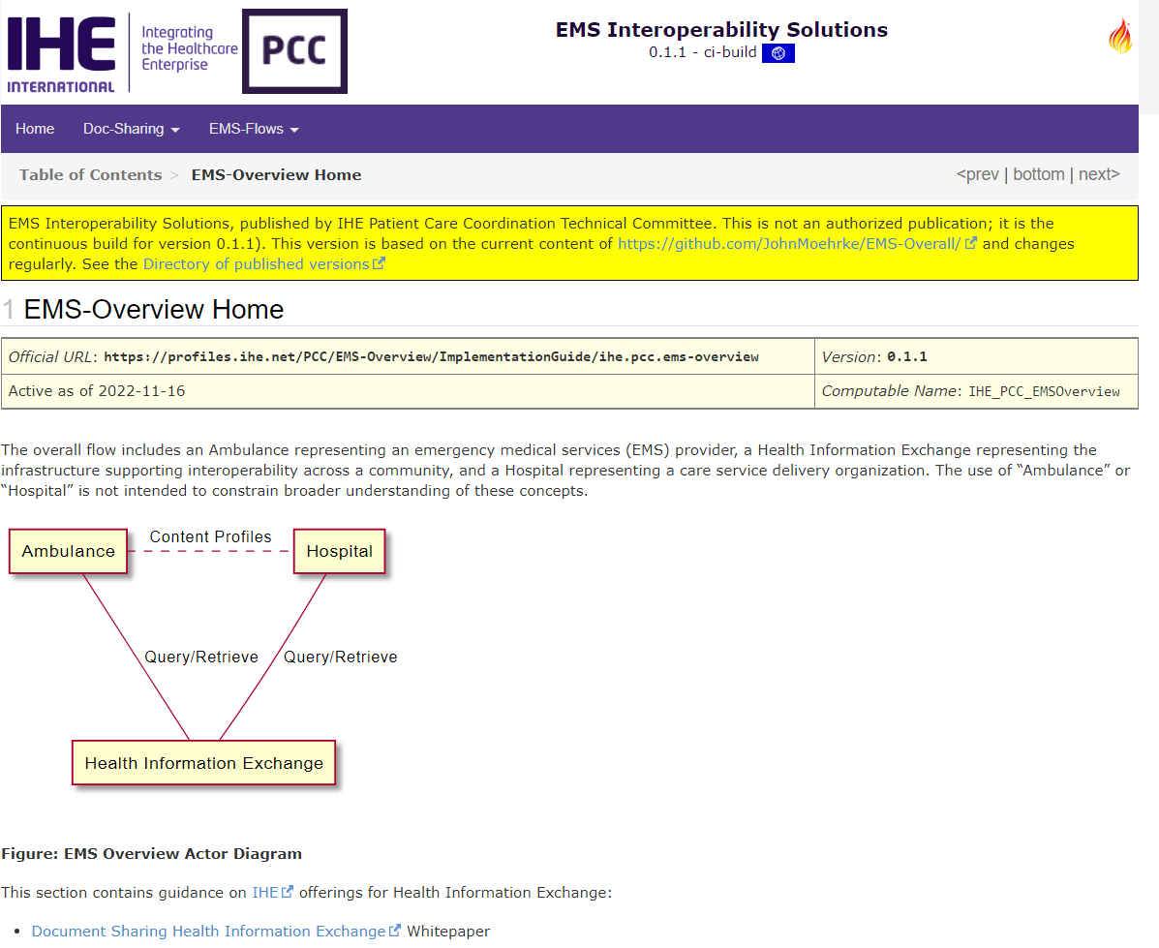
Prototype IG
Ambulance and Hospital communicate using the HIE
The clinical content is essentially communicated just between them
Communication is as needed when needed
Notes:
You can navigate using the purple menu, or using the prev/next.
There are many links that can be used to get to the underlying specifications

Slide 5
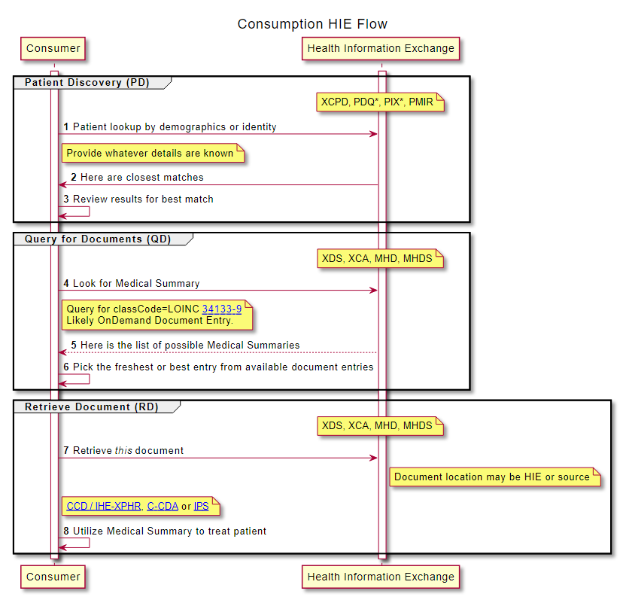
Consuming content
Patient Discovery to find identifiers used in the community for the patient
Query for Documents to find potential documents
Query parameters can be used to limit the results
E.g. Medical Summary
Gives metadata about all matches
Retrieve Document to retrieve the document itself
Notes:
This is foundation of existing exchanges and

Slide 6
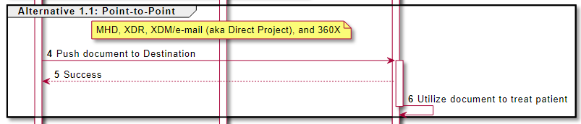
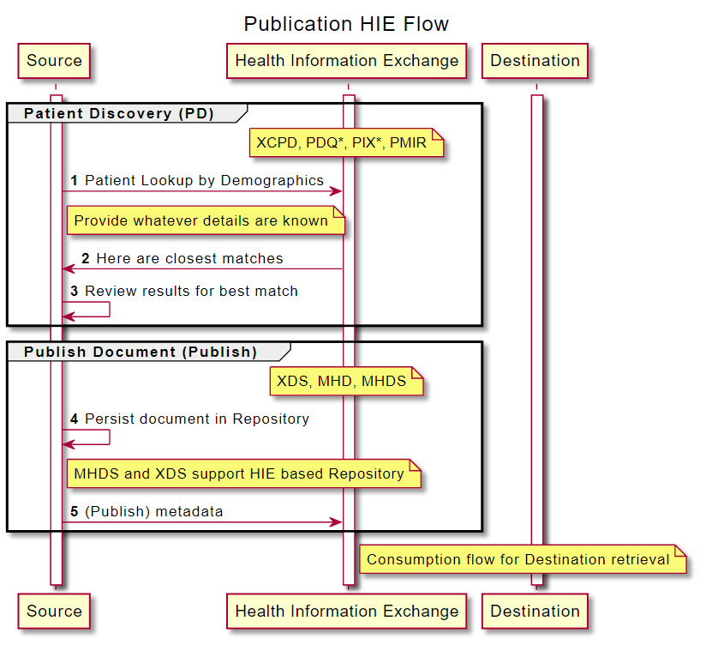
Publication and Push workflows
Push workflows can be used to deliver a document to a specific endpoint
Allowance to carry patient demographics rather than lookup
E.g. Direct Project, 360X, or XDR push
Publication workflows can be specific use or available for future
Repository may be at the Source, or within the HIE

Slide 7
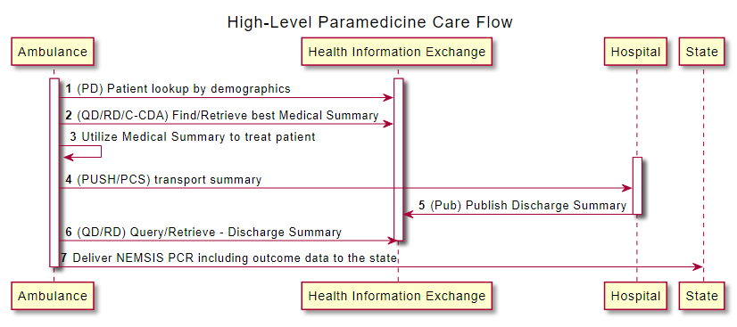
High-level Paramedicine Care Flow

Slide 8
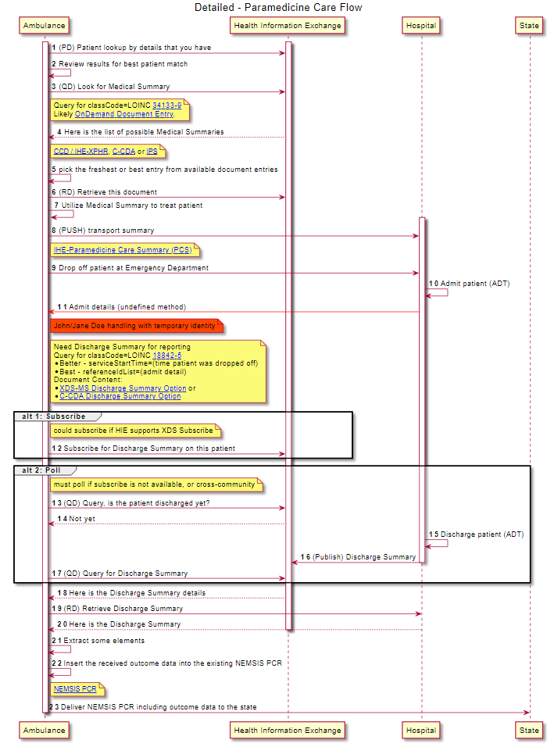
Details

Slide 9
1st get Medical Summary use it to treat

Slide 10
2nd get Discharge Summary 3rd report to state

Slide 11
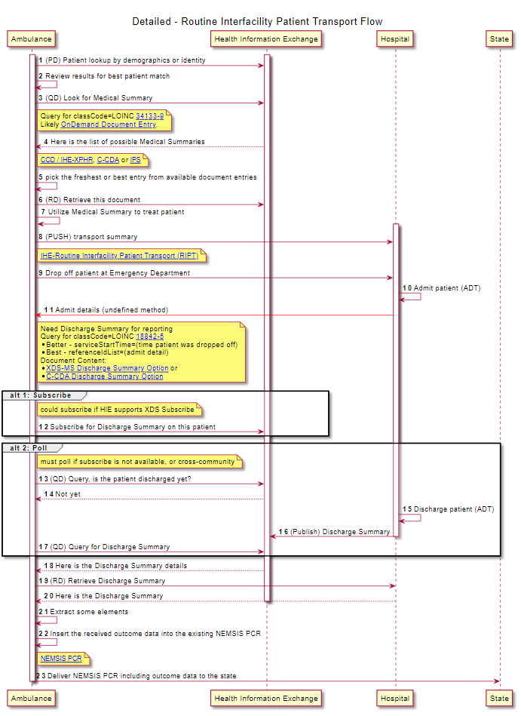
Routing Interfacility Transport

Slide 12
Gaps
Jane/John Doe handling
Communication of Registration details so that finding Discharge Summary is easier
Work out which mechanism EMS uses to publish or push content
Policy - Need to get EMS community connected to HIE
Other?

Slide 13
Additional Resources
IHE Profiles – https://profiles.ihe.net
Document Sharing Whitepaper - https://profiles.ihe.net/ITI/HIE-Whitepaper
IHE International YouTube channel - https://www.youtube.com/user/IHEIntl
Document Sharing: https://www.youtube.com/watch?v=3sDgnS71m4o
MHD - https://www.youtube.com/watch?v=ZpQrHI3VVxY
mXDE - https://www.youtube.com/watch?v=o24WQgxiYVI
Introduction to IHE - https://wiki.ihe.net/index.php/Introduction_to_IHE
IHE USA – www.iheusa.org
EMS Overview - http://build.fhir.org/ig/JohnMoehrke/EMS-Overall

